Slide 1
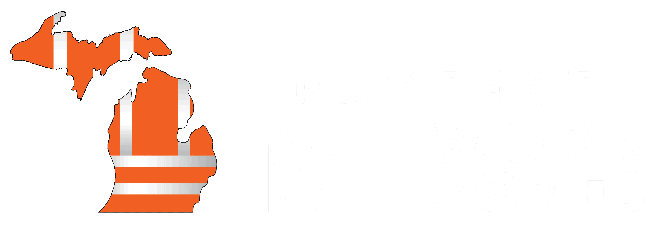
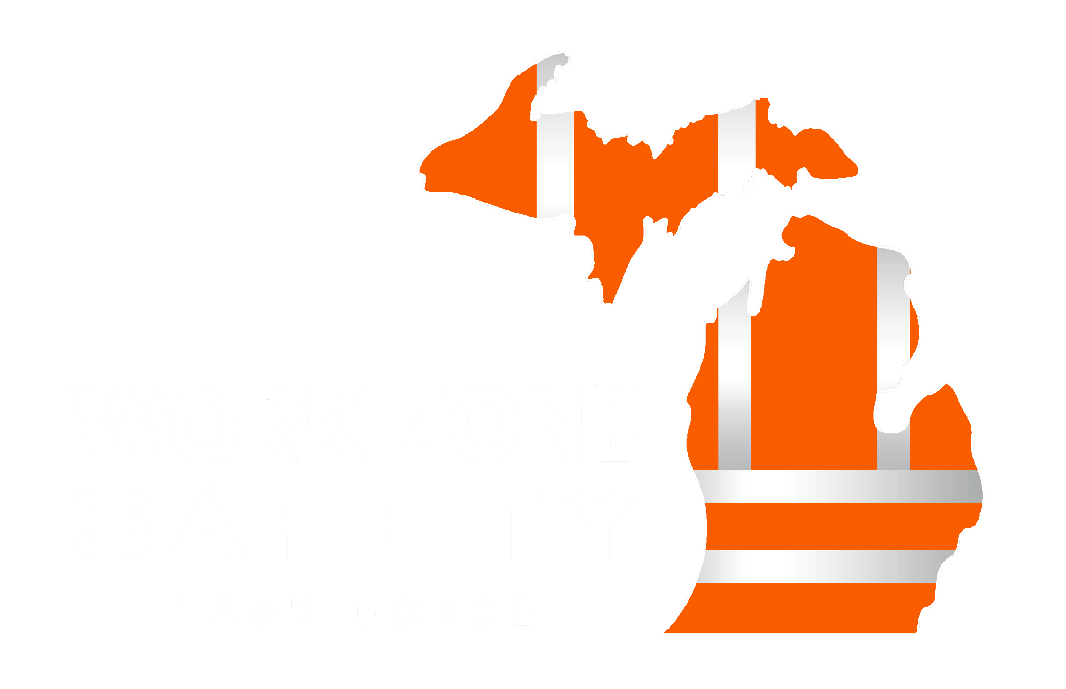
The WZSTF
The Michigan Work Zone Safety Task Force (WZSTF) was officially launched in October 2018 as a collaborative effort between the Michigan Department of Transportation (MDOT) and Michigan’s heavy-highway construction industry. It is the goal of the task force to reduce and eliminate work zone injuries and deaths for construction workers and motorists.
Our Mission: Working together, MDOT and the heavy-highway construction industry are advancing our culture and practices to put SAFETY FIRST in Michigan’s work zones.

Slide 2
Industry Partners
The Michigan Work Zone Safety Task Force has seven action teams with over 90 team members. Each action team is led by one MDOT and one industry representative with equal representation from contractors and MDOT. Additional members on the teams may include other state agencies, consulting engineers, designers, and other industry partners.
Our Mission: Working together, MDOT and the heavy-highway construction industry are advancing our culture and practices to put SAFETY FIRST in Michigan’s work zones.

Slide 3
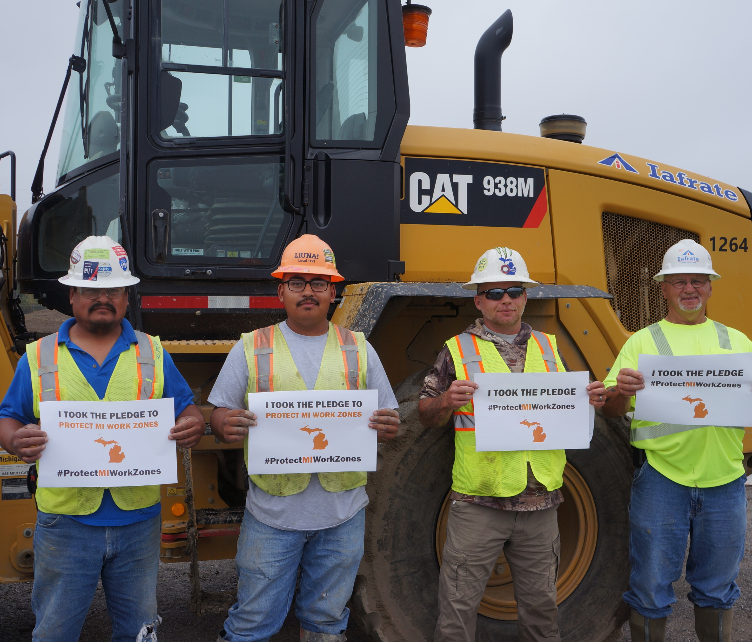
Help us reach our goal.
The Protect MI Work Zones campaign was formed in collaboration with industry partners and the goal of protecting Michigan work zones through support and accountability.

Slide 4
Together we can achieve zero deaths.
Michigan's goal “Toward Zero Deaths” on our roads includes our work zones. By taking the pledge, you can help us to achieve our goal of zero work zone injuries.
TOGETHER we can achieve zero deaths on our roads and in our work zones!

Slide 5
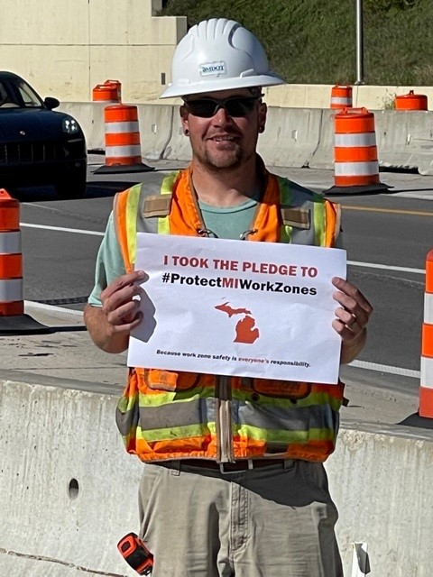
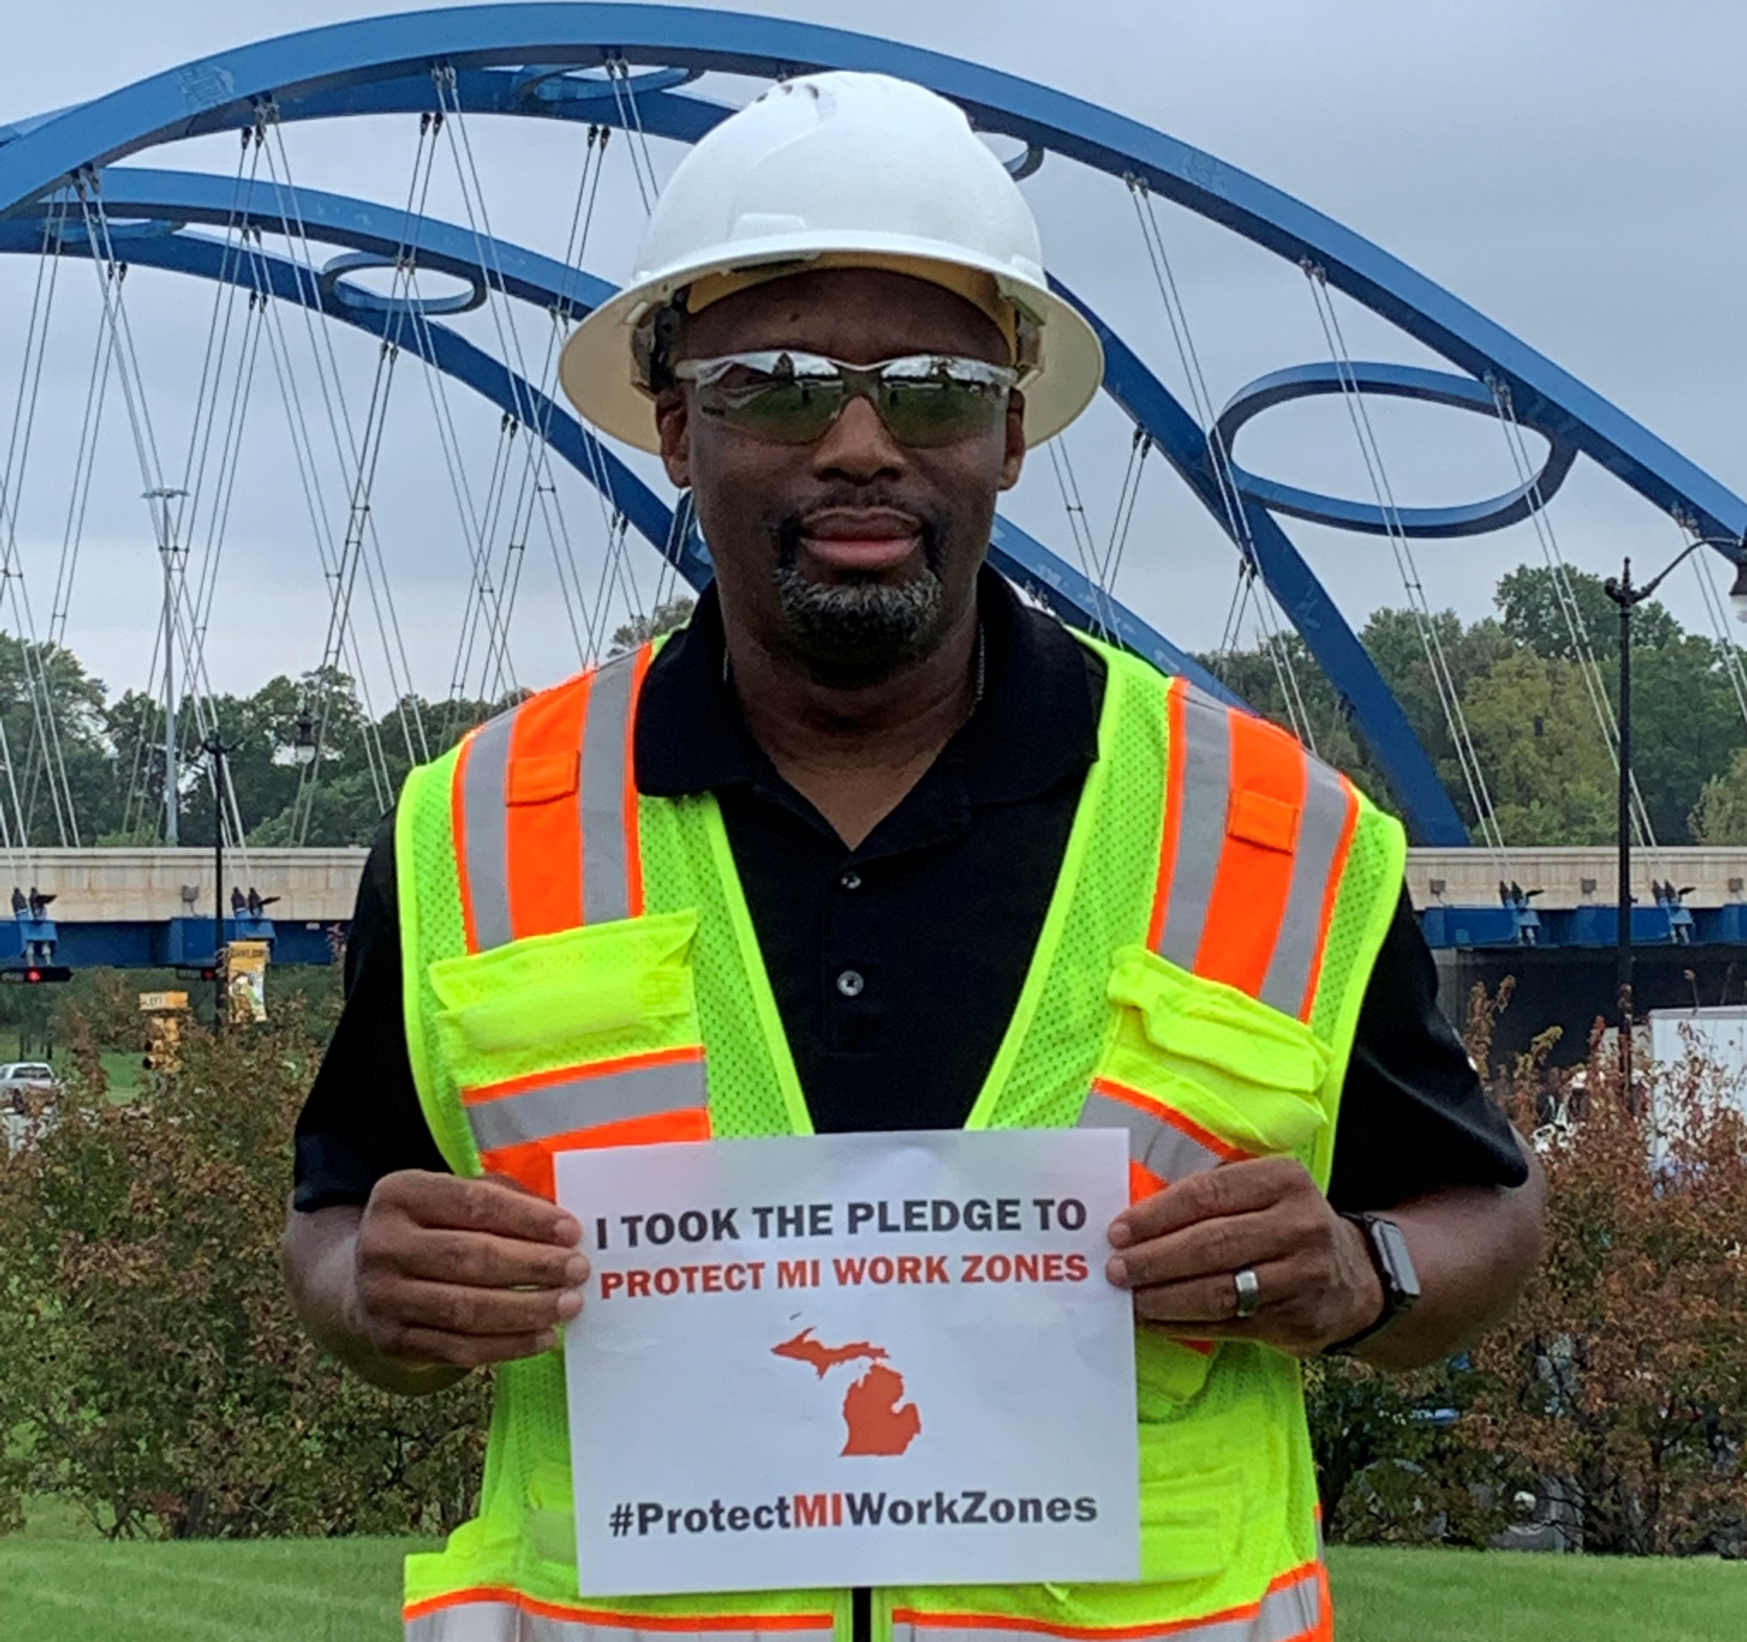
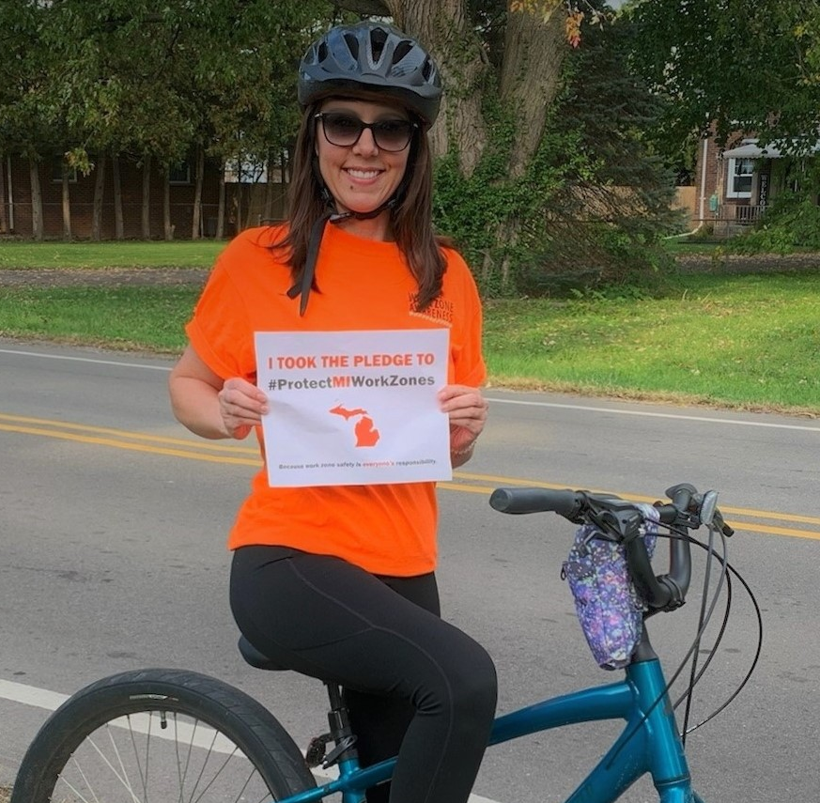

Slide 6
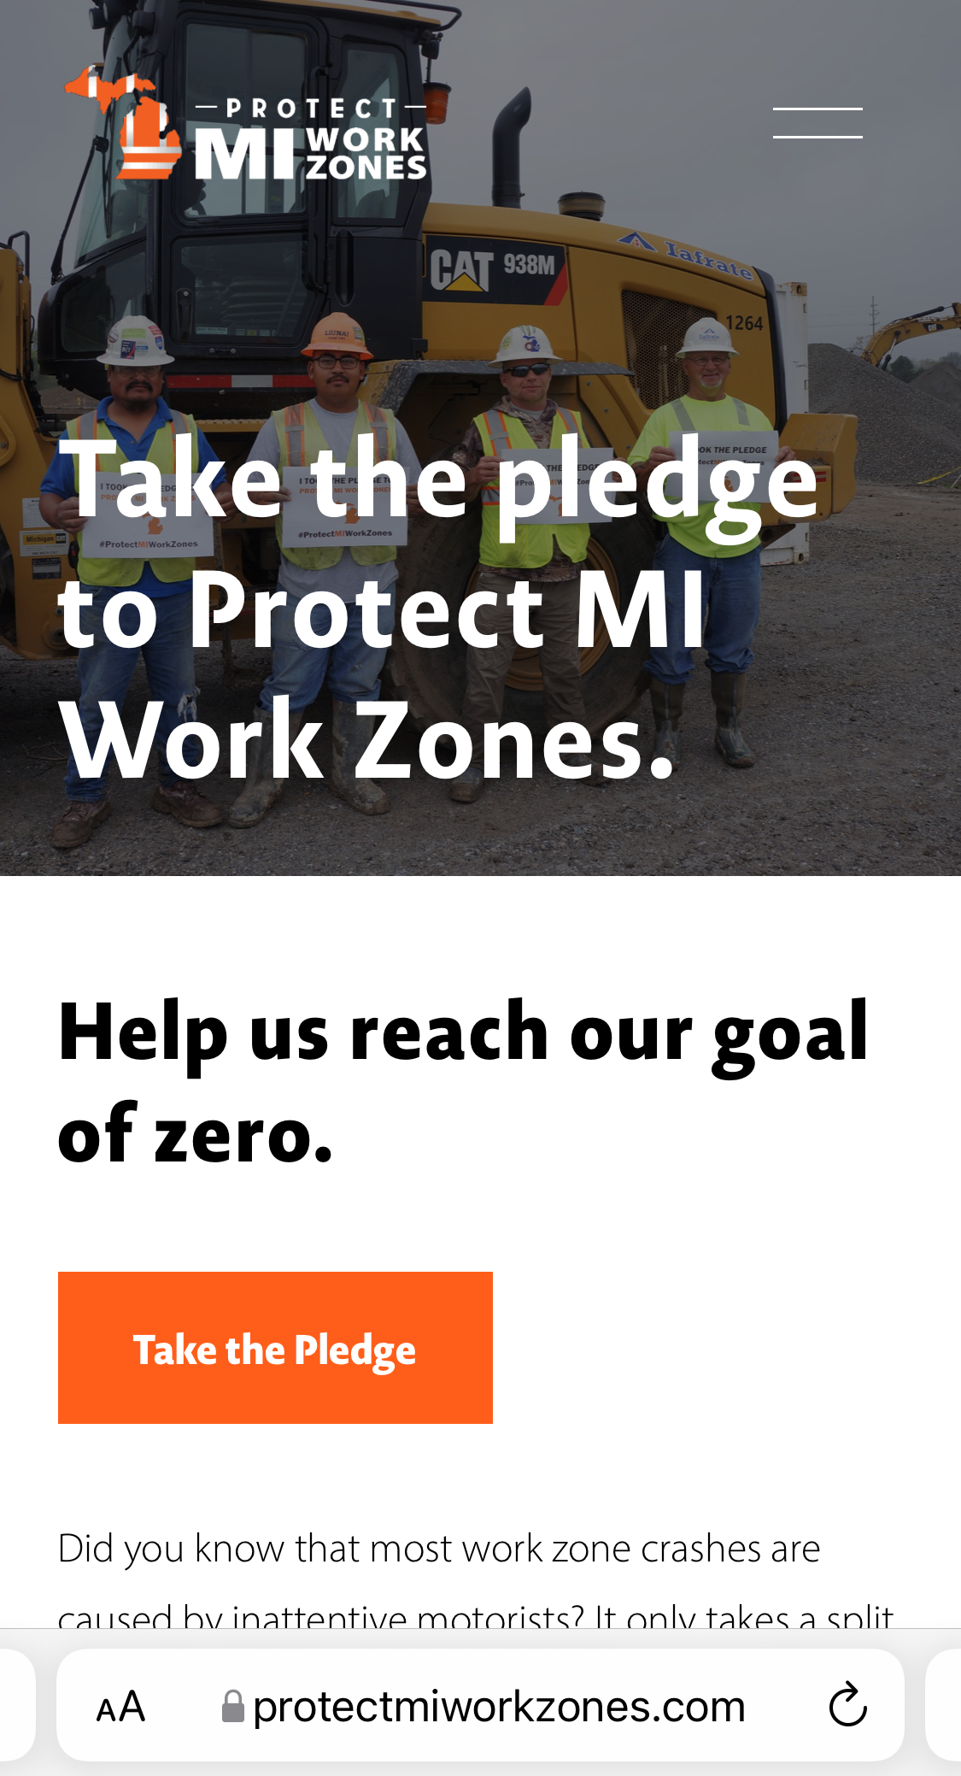
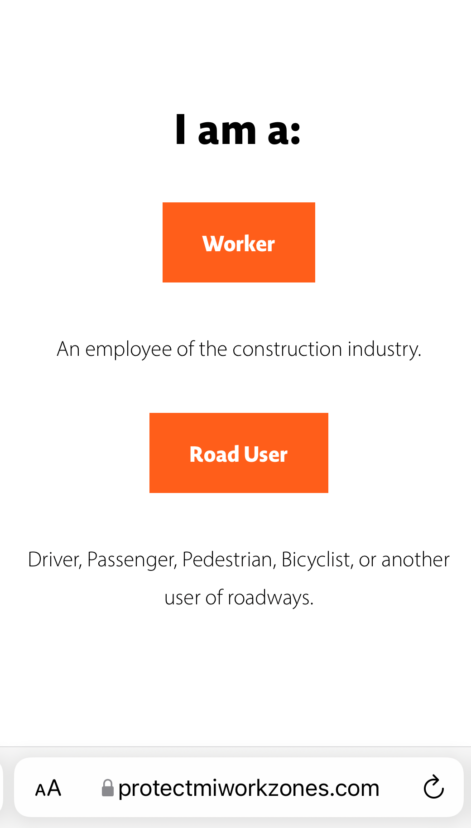
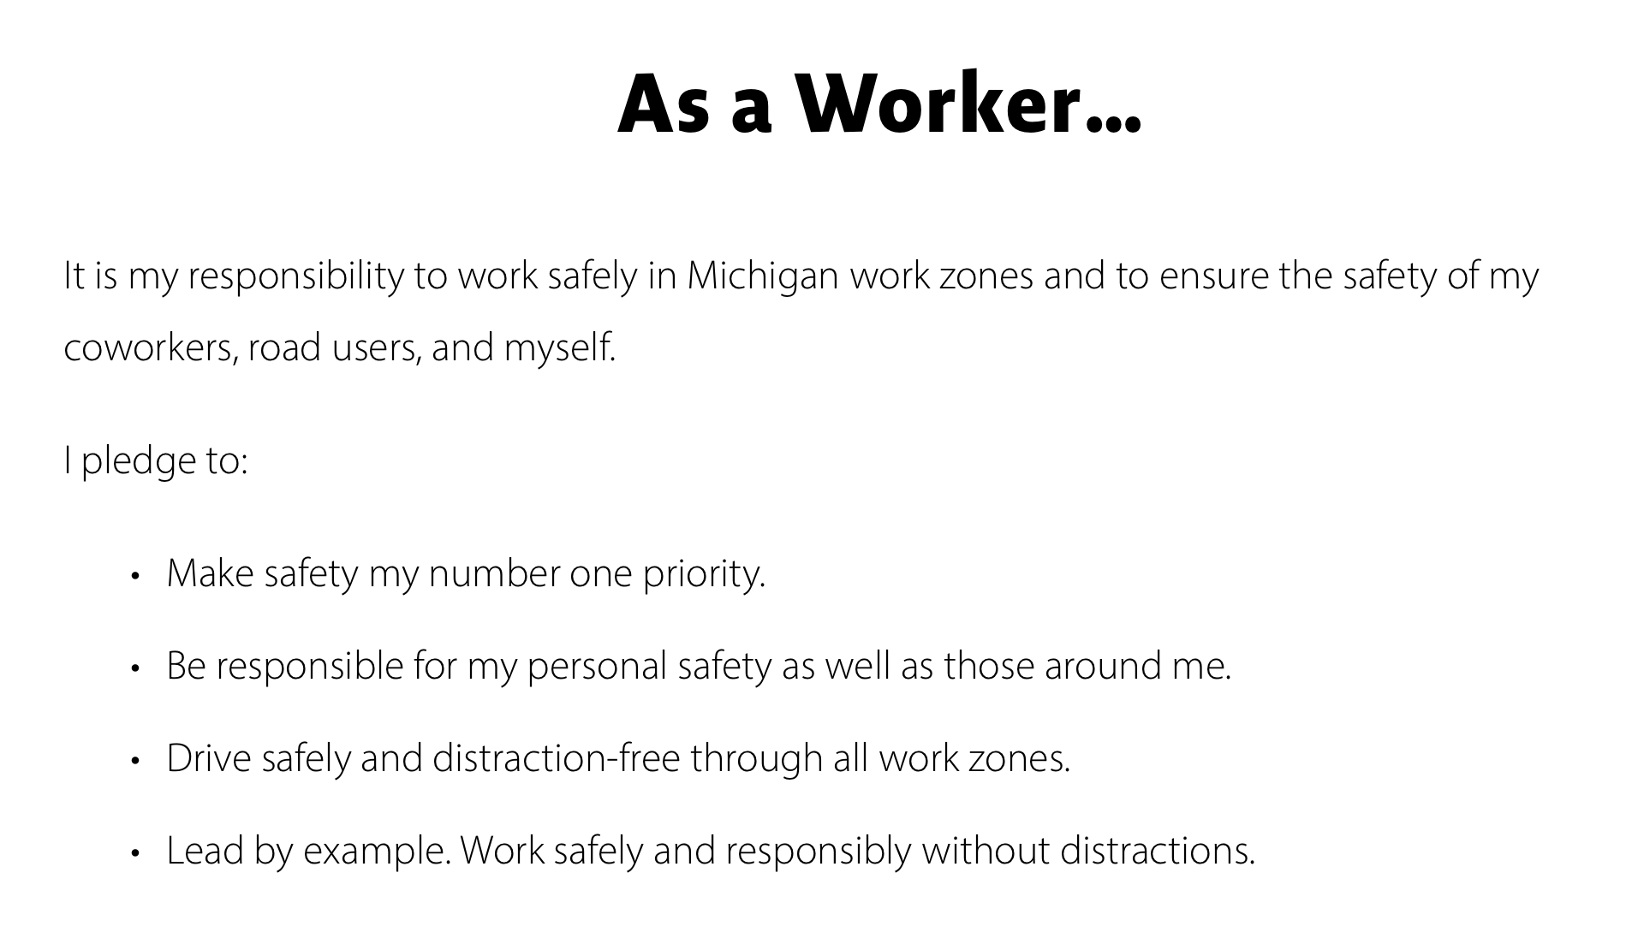
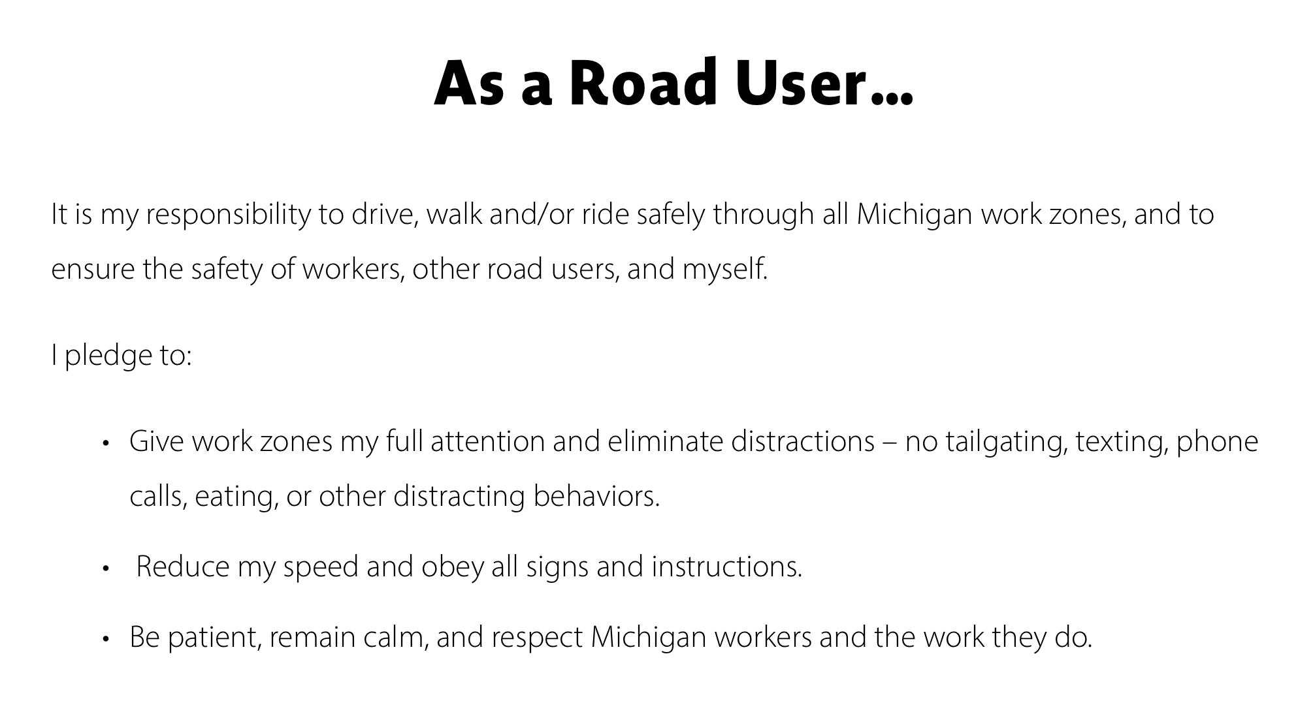
PROTECTMIWORKZONES.COM

Slide 7
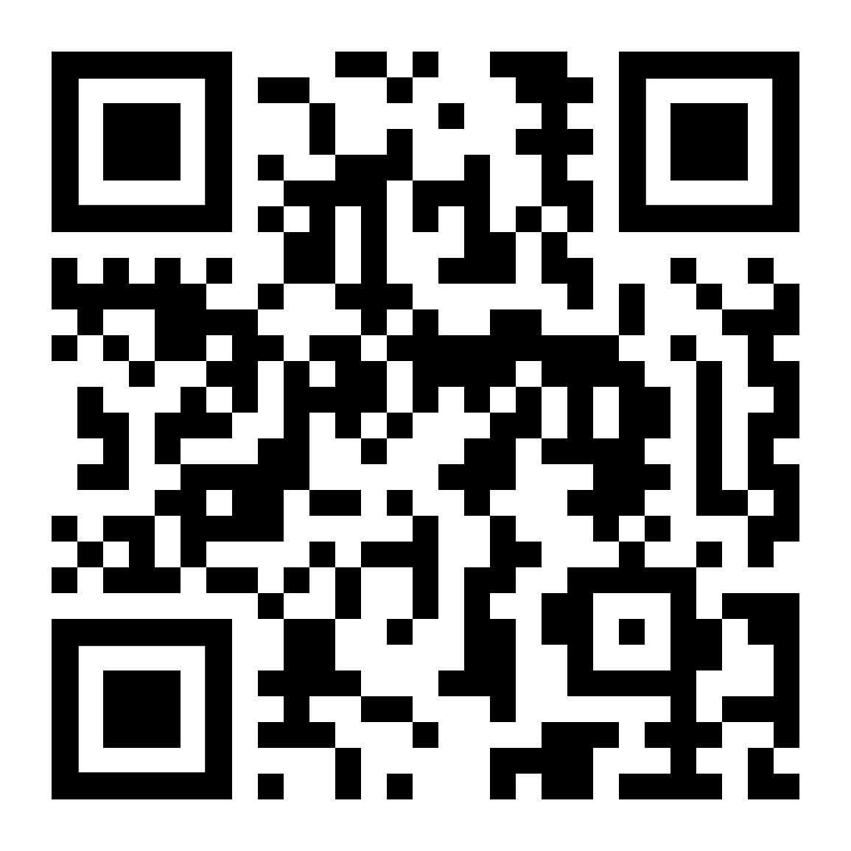
PROTECTMIWORKZONES.COM

